Slide 1

UrbarnCart Sales Analysis
This is a projects based on PostgreSQL
Naimur Rahman
Date:20—01-2026

Slide 2
About this project :
This project analyzes UrbanCart’s sales data using SQL to uncover actionable business insights related to revenue performance, product trends, and customer purchasing behavior. By querying transactional and dimensional data, the analysis explores key questions such as revenue distribution, top-performing and underperforming products, frequently purchased product combinations, customer ordering patterns, and order value drivers.
Business problem and objectives:
sales performance of Urban Cart
Identify top products, customers, and trends
Support data-driven decision making
Dataset Description :
Content
Tables used:
  fact_order
  fact_order_items
  dim_products
  dim_customers
Time period: 10/1/2025-9/30/2025
Key metrics: revenue, quantity, orders

Slide 3
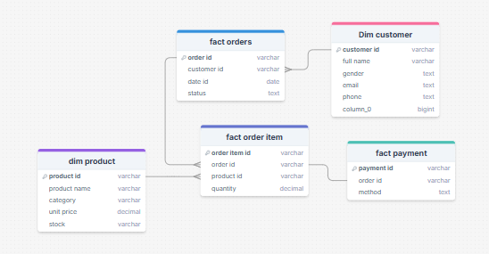
ER Diagram:

Slide 4



Order description:
Total order :
Output :
Total order without calcelled order
Total order without completed order
Order Summary (September 30, 2025 – October 1, 2025)
During this period, UrbanCart recorded a total of 1,200 orders. Of these, 713 orders were successfully completed. The remaining 487 orders were not completed, including 241 orders currently in a pending state, while the rest were cancelled.

Slide 5

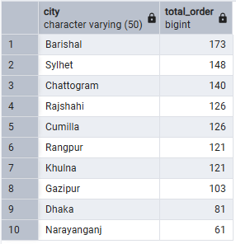
Number of unique customers have placed at least one order
Output :
Comments:
There are 100 unique customer who ordered from the UrbanCard during the time.
The cities which generate the highest number of orders
Output :
Comments:
Out of the 1,200 total orders, Barishal generated the highest number of orders (173), followed by Sylhet (148) and Chattogram (140). The remaining orders were distributed across other cities, as shown in the accompanying output.

Slide 6

The percentage of customers have placed more than one order
Output :
Comments:
The analysis shows that 100% of customers have placed multiple orders, indicating a fully repeat-customer base.
Monthly trend of total orders over time
Comments:
The chart shows that order volume peaked in October, declined slightly in November, and dropped further in December.

Slide 7
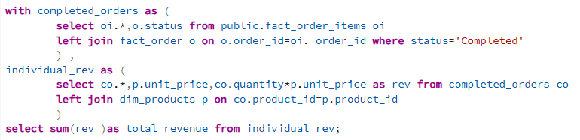

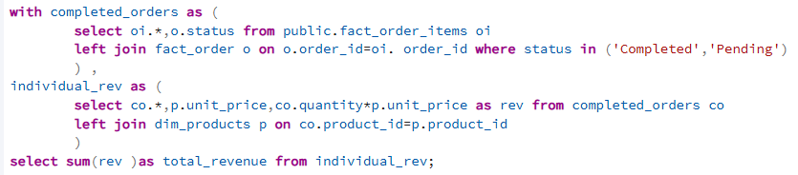

The total revenue generated by UrbanCart
Output :
Comments: The total revenue from the UrbanCart is 13,53,914 Taka. Here only the completed order were taken into count.
Output :
Comments: Total revenue is projected to reach 1,789,715 Taka, assuming all pending orders are successfully completed.

Slide 8
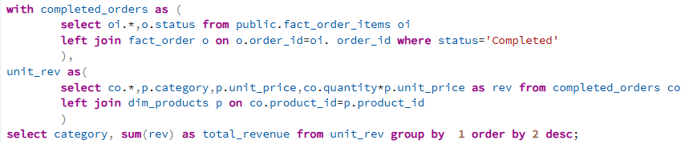
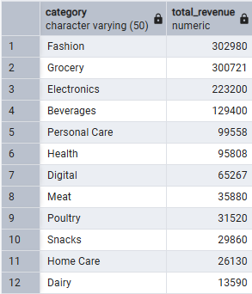
Product categories that contribute the most to total revenue.
Comments:
The chart clearly indicates that the Fashion category generates the highest revenue for UrbanCart, followed by Grocery and Electronics. This analysis considers only completed orders.

Slide 9
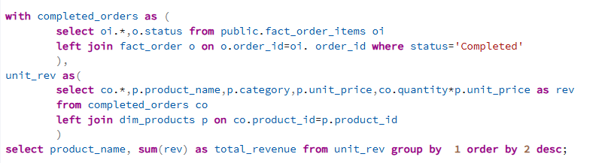
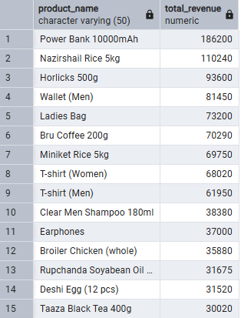
Individual products wise revenue :
Comments:
The SQL query is used to calculate product-wise revenue, with only the top 15 products displayed in both the output table and the bar chart. The results indicate that Power Bank (1000 mAh) generates the highest revenue, followed by Nazir Shali Rice (500 kg) and Horlicks (500 g). These top-performing products contribute significantly to overall sales, highlighting key revenue drivers within the product portfolio.

Slide 10
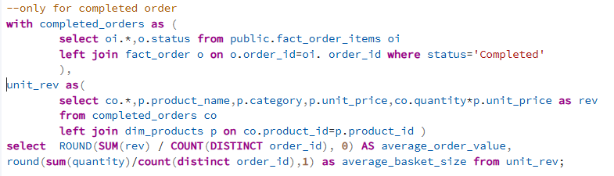


The average order value (AOV) and Average Basket Size :
Output :
If considering the order of completed and pending orders, then the query need to slight change in
Output :
Comments:
Considering only completed orders, the average order value (AOV) is 1,899 Taka, while the average basket size is 9.9 items. This indicates that, on average, each order generates 1,899 Taka in revenue, and customers typically purchase around 10 products per order.
Considering completed and pending orders , the average order value(AOV) is 1876 Taka, and average basket size is 10 items.

Slide 11
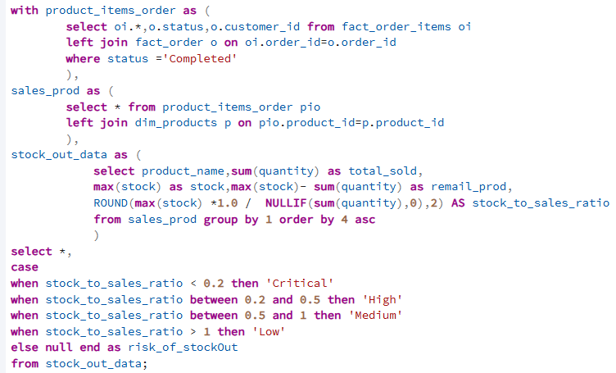
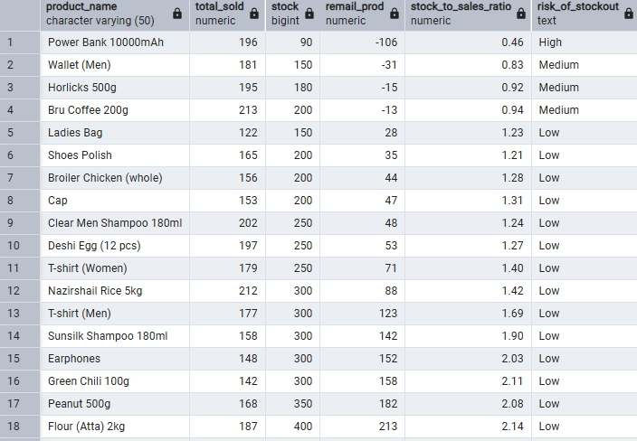
products are at risk of stock-out due to high sales volume and low inventory :

Slide 12
Comments:
The chart illustrates the stock-to-sales ratio to assess the risk of stock-out across products. A ratio between 0.2 and 0.5 indicates a high risk of stock-out, within which Power Bank (1000 mAh) falls, making it the most vulnerable product. Products with a ratio between 0.5 and 1 are classified as having a medium risk of stock-out, including Wallet, Horlicks (500 g), and Bru Coffee (200 g). Products with a stock-to-sales ratio greater than 1 are considered to have a low risk of stock-out.
Given that Power Bank (1000 mAh) and Wallet, Horlicks (500 g), and Bru Coffee (200 g) fall into the high- and medium-risk categories, management should prioritize increasing production or inventory levels for these products to reduce the likelihood of stock-outs and meet customer demand effectively.

Slide 13
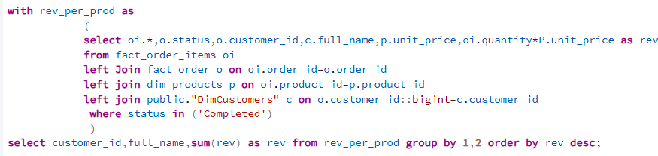
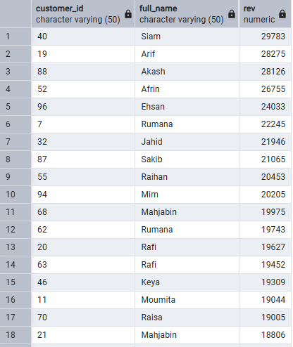
The customers who contribute the highest to total revenue
Comments:
The output of the SQL query identifies the top 18 customers who contribute the highest share of total revenue, based exclusively on completed orders. These customers represent UrbanCart’s most valuable customer segment. To maintain their strong purchasing behavior and enhance customer loyalty, UrbanCart may consider offering targeted discounts, loyalty rewards, or exclusive incentives to retain these high-value customers.

Slide 14
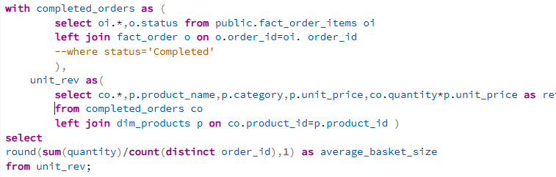

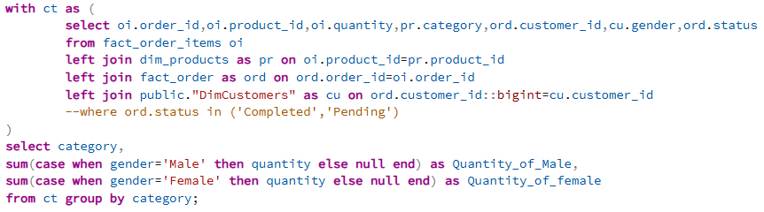
The average number of products purchased per order
Output :
Comments:
The average basket size of the UrbanCart is 10, that means per order there are 10 unit of product.
Male and female customers purchasing patterns by category

Slide 15
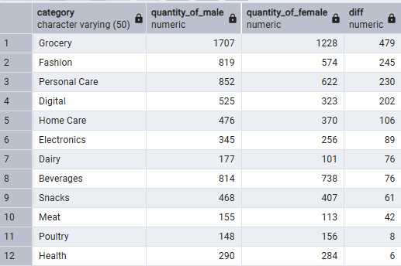
Comments:
The graph shows that, overall, male customers purchase more products than female customers. The products include Grocery, Fashion, Personal Care, Digital, Home Care, Electronics, Dairy, Beverages, Snacks, and Meat. Specifically, males buy more than females in Grocery, Fashion, Personal Care, Digital, and Home Care, in ascending order of difference.

Slide 16
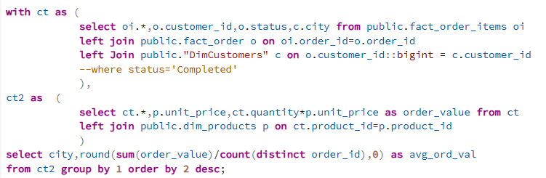
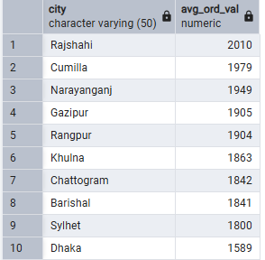
The cities which have the highest average order value
Comments:
The output showing that Rajshahi generate highest average order value, following Cumilla , and Narayanganj.
Where all cancelled, completed, and pending orders are considered. Sylhet and Dhaka generate lowest average order value.

Slide 17
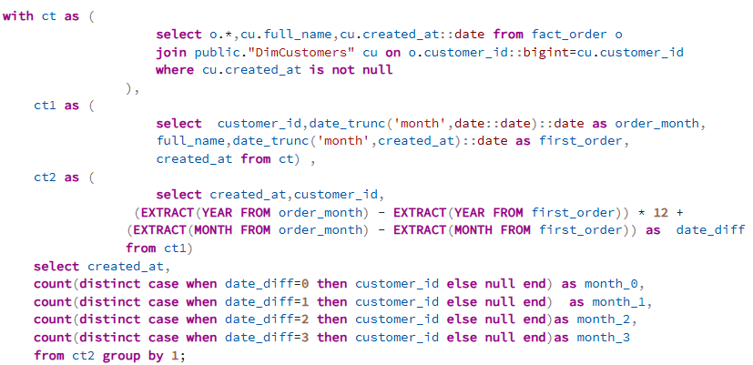
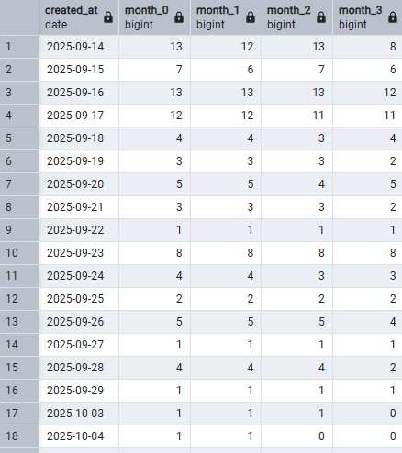
The way customer purchasing behavior change over time since account creation
Comments:
The output shows customers grouped by their account creation date and their arrivals over the next three months. For example, customers who created an account on 2025-09-14 had 12 out of 13 arrivals in the first month, all 13 in the second month, and 8 in the third month. Similar patterns are displayed for other account creation dates.

Slide 18
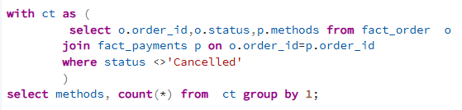
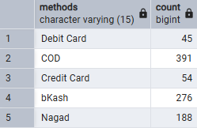
The payment methods are used most frequently
Comments:
The output and corresponding bar chart indicate that Cash on Delivery is the most popular payment method, with 391 orders. Bkash follows in second place with 276 orders, while Nagad accounts for 188 orders. Credit Card and Debit Card payments are the least used, with 54 and 45 orders, respectively.
Cancelled orders are not included in this analysis.

Slide 19
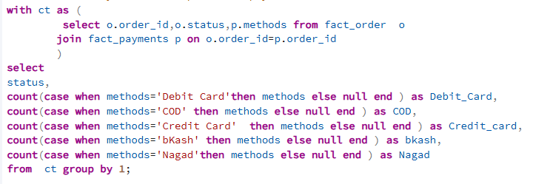
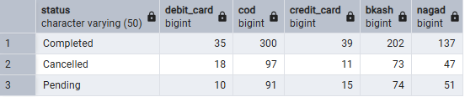
Relation between payment method and order status:
Comments:
In the clustered column chart, Cash on Delivery (COD) has the highest number of completed orders, but it also shows a large number of cancelled orders. A similar pattern is observed for Bkash and Nagad, although both have relatively similar proportions of completed, cancelled, and pending orders. This indicates that COD is associated with a higher number of cancelled orders, suggesting a relationship between payment method and order status. To determine whether this relationship is statistically significant, a Chi-square test should be conducted..

Slide 20
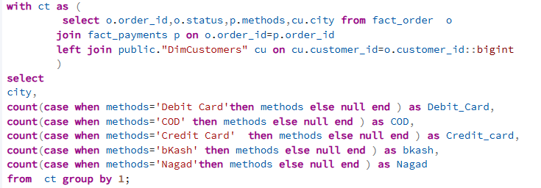
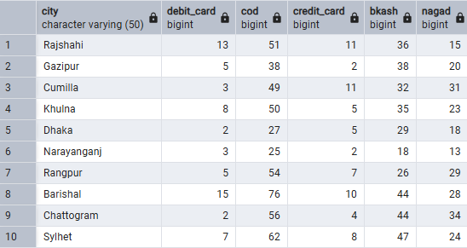
Payment Method Preferences Across Cities:
Comments:
The query output shows that, overall, most cities prefer Cash on Delivery (COD), followed by Bkash and then Nagad. However, there are some city-specific variations: people in Dhaka prefer Bkash over COD, while Gazipur residents use COD and Bkash in nearly equal proportions. The use of Debit Card and Credit Card remains low across all cities.

Slide 21
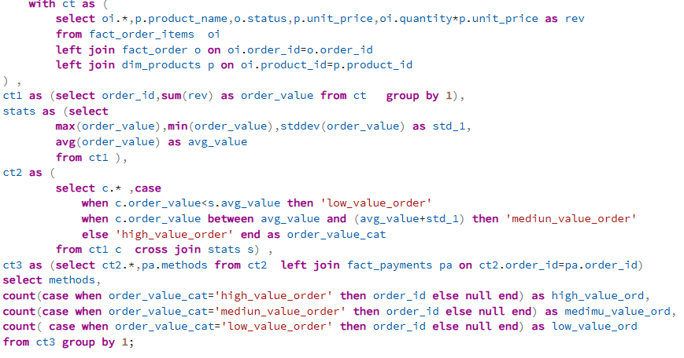
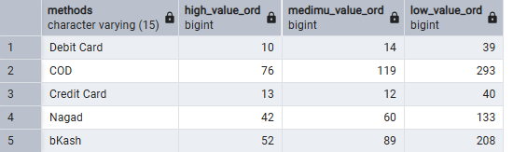
Association between high-value-order and specific payment method:
Comments:
Here in the output of the SQL query, it is shown that large number of the high value orders are ordered through COD than others method. Though in all types of order are most of the time used through COD. Among all orders of high value 76 used COD, 52 used Bkash, 42 used Nagad, only 23 used credit/debit card, so maybe there is some association. To assessing the significance, a chi-square test should be done.

Slide 22
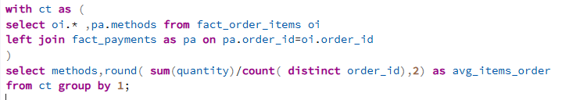
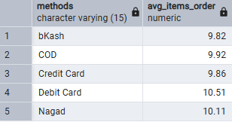
The average number of items per order by payment metho
Comments:
Her in the chart it is clearly shows that the person who use Debit Card have height average items in order (10.51), the second position takes, Nagad , where it’s average items per order is 10.11, the lowest average items per order is in Bkash that is 9.82.

Slide 23
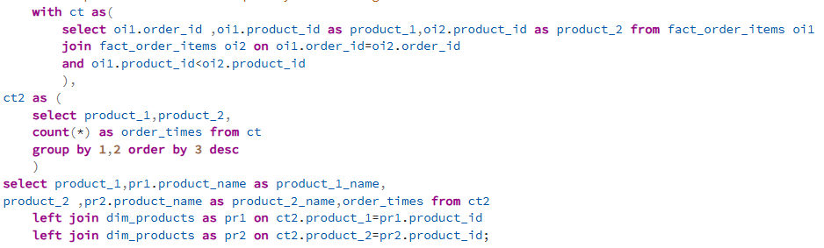
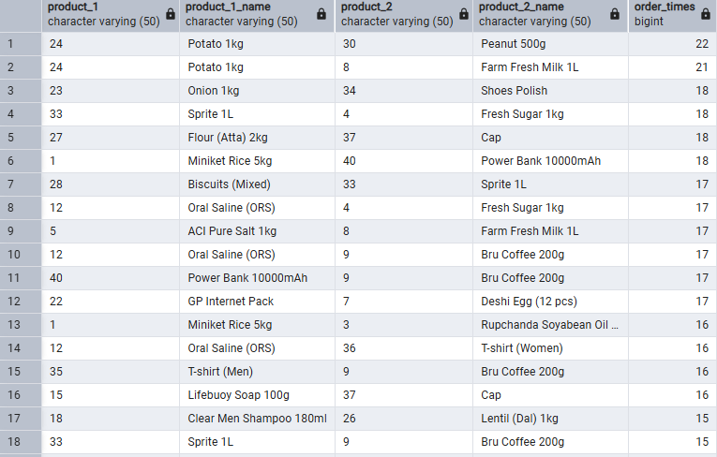
The products are most frequently ordered together
Comments:
Here in the SQL query output found the top 18 pair of products that bought most frequently together. Here Potato 1kg, Peanut 500g bought together in 22 times, then in the second position Potato 1kg and Farm Fresh Milk 1L bought 21 times, then there are some products
that bought 18 times together and rest of them are showed in the output table.

Slide 24
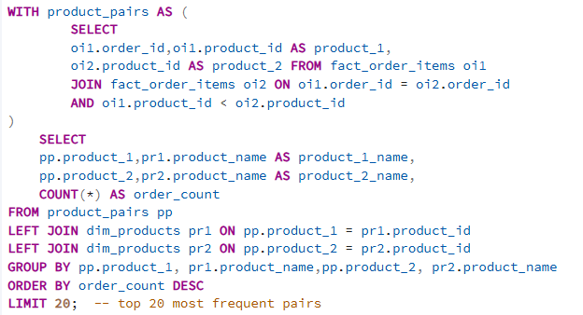
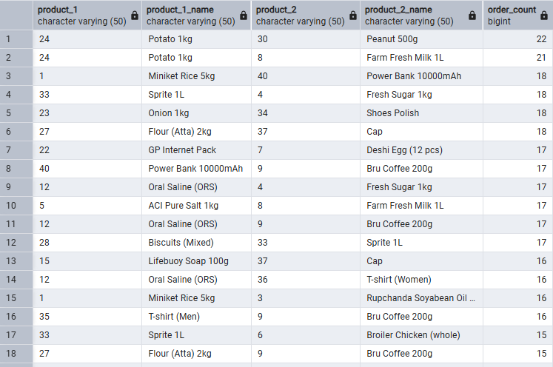
The product pairs appear most often across all orders
Comments:
Here in the SQL query output found the top 18 pair of products that bought most frequently together. Here Potato 1kg, Peanut 500g bought together in 22 times, then in the second position Potato 1kg and Farm Fresh Milk 1L bought 21 times, then there are some products
that bought 18 times together and rest of them are showed in the output table.

Slide 25
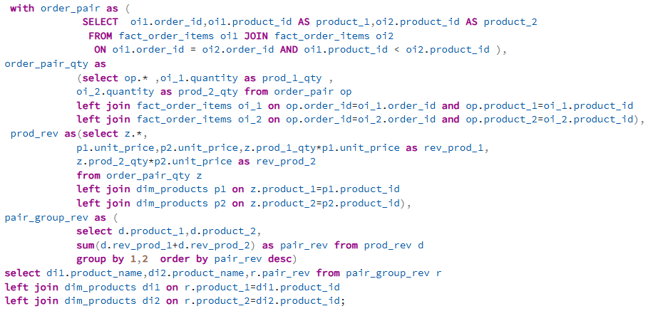
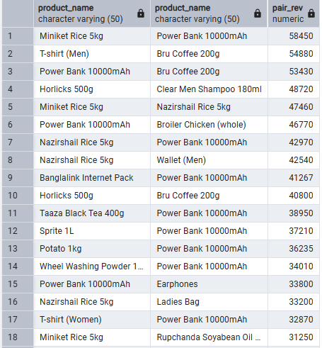
The product pairs that consistently drive higher order values
Comments:
The SQL output indicates that certain product pairs ordered together generate higher revenue. The combination of Miniket Rice 5kg and Power Bank 1000mAh produces the highest revenue when purchased together. The second-highest revenue comes from T-Shirt (Men) and Bru Coffee 200g, followed by Power Bank 1000mAh and Bru Coffee 200g in third place.
These results suggest strong cross-purchase behavior among these items. Therefore, it is highly recommended to place high-revenue product pairs together through product bundling, recommendations, or strategic shelf placement to maximize overall sales.

Slide 26
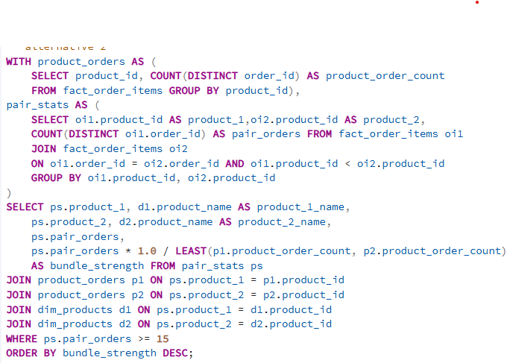
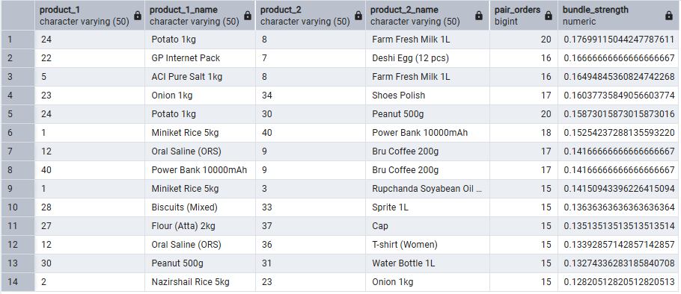
The product combinations could be recommended as bundles to increase revenue
The SQL output highlights product pairs that are frequently purchased together and shows their bundle strength, which measures how strongly two products are associated relative to their individual order volumes. Product pairs with higher bundle strength indicate a strong co-purchasing pattern, meaning customers who buy one product are very likely to buy the other as well.
The results show that several (Potato 1kg – Farm Fresh Milk 1L) combinations have strong bundling relationships, with a minimum of 20 shared orders. These high bundle-strength pairs represent valuable opportunities for product bundling, cross-selling, and recommendation strategies. Placing these products together or promoting them as bundles can help increase order value and improve overall revenue performance.
Based on this SQL query some other combination that have strong relationships are presented in the SQL output.

Slide 27
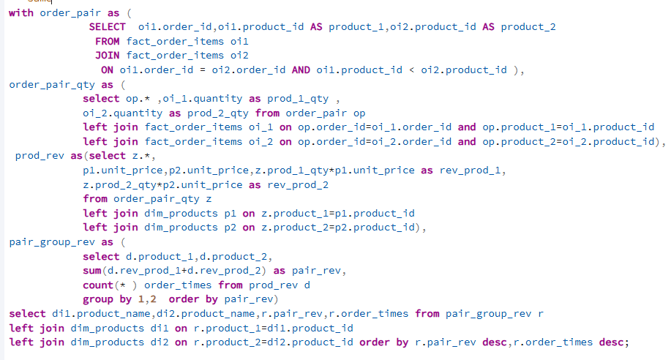
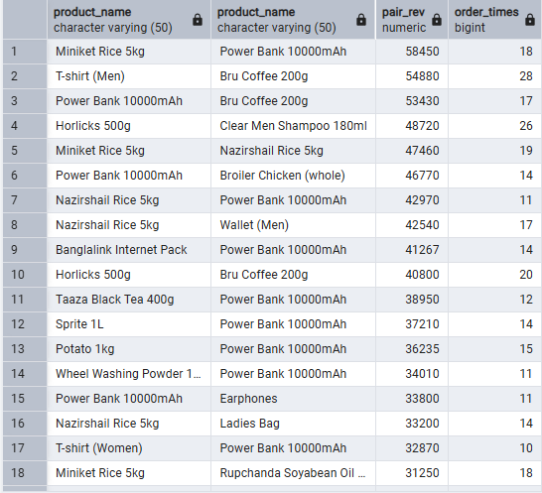
The product pairs that consistently drive higher order values
This analysis goes beyond a single top-performing pair and examines multiple product combinations that customers frequently purchase together. The results reveal a wide range of (Product – Product) pairs that consistently appear in the same orders and contribute meaningful revenue.
While some pairs generate exceptionally high revenue, several other combinations show strong purchase frequency with moderate revenue contribution. These patterns suggest different types of cross-selling opportunities:• High-revenue pairs are suitable for premium bundles and featured promotions.• High-frequency but moderate-revenue pairs can be leveraged for recommendation engines and add-on suggestions.
Overall, promoting multiple complementary product pairs rather than focusing on a single combination can help Urban Cart reach diverse customer needs, increase average order value, and improve cross-selling performance across categories.

